Slide 1
TypeScript for the JavaScript Developer
Gabrielle Crevecoeur
JS/TS PM
@Nowayshecodes

Slide 2

Things you will need
Code Editor
Terminal Window
Node.js Installed
Package Manager Installed
npm
yarn
pnpm

Slide 3
Installing TypeScript
npm
npm install -D typescript
yarn
yarn add typescript -D
pnpm
pnpm add -D typescript

Slide 4

So How Is TypeScript Different?
Fun Fact: Your existing JavaScript code is valid TypeScript code. Your strings, numbers, objects and functions all work.
TypeScript then adds a little “razzle dazzle”, that we call a type system.
Notes:
TypeScript is a language that is a superset of JavaScript: JS syntax is therefore legal TS. Syntax refers to the way we write text to form a program

Slide 5
So How Is TypeScript Different?
TypeScript, like many other programming languages, detects errors in code before running the code.
TypeScript errors are based on the kinds of values being created and used in the code. This is called static type checking
Notes:
- Syntax errors come from JavaScript or with using a linter

Slide 6
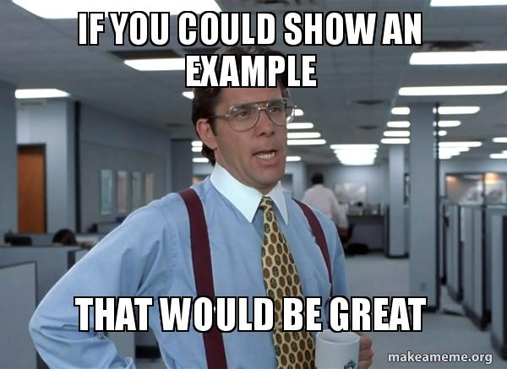
Notes:
Area examples

Slide 7
Compiling TypeScript Code
Your TypeScript code will be compiled down into JavaScript code.
This will:
Allow you to run your code
Guarantee that TypeScript will never change the runtime behavior of JavaScript code, despite the additional code checking
To compile your code simply use tsc
tsc areaInTS.ts
Notes:
In this case im using a global version of typescript to run tsc

Slide 8
What will we be exploring next?
Defining Types
Interfaces
Type Annotations
Classes
Complex Types
Checking Types in a JavaScript file
TypeScript On The Web
Popular Frameworks
Notes:
Popular frameworks: https://www.typescriptlang.org/docs/bootstrap

Slide 9
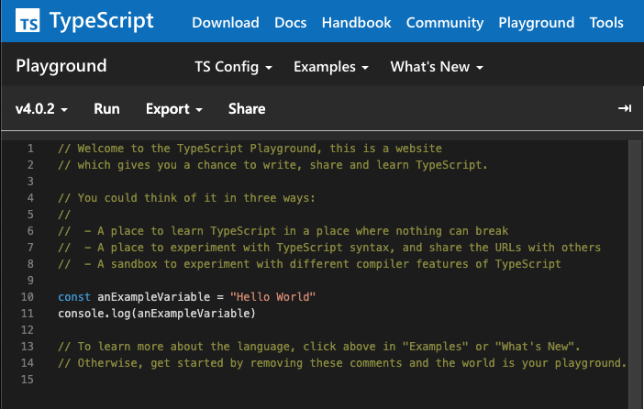
Want more before you commit?
Notes:
Speak on the TypeScript website and the playground

Slide 10

Full on Question Mode!

